Slide 1
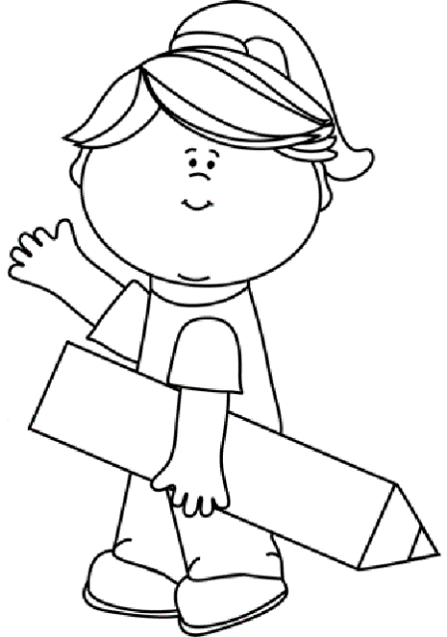
Summer 2
Year 2
Weekly Spelling Booklet
Name:
Please return this book to school every Thursday.

Slide 2
Note to Parents
This book contains the spelling that your child needs to learn each week for this term. There are ten spellings to learn each week, taken from the phonics sounds that have been taught in class. The last four spellings highlighted in red are Year 2 common exception words.
This book then needs to be returned to school every Thursday, so child can complete their weekly tests in it. The book will then be sent home again on the Friday evening so you can see how well your child has done, and learn the following week’s spellings. Any assistance that you can give your child would be greatly appreciate.
Many Thanks
Mrs McHugh
Don’t forget to use spelling shed, where you can play games connected to each week’s spellings.
https://www.spellingshed.com/en-gb

Slide 3
Week 1
/r/
Date of test: Thursday 5th June
Look and Say | Cover | Write 1st try | Check and Cover again | Write 2nd try | Check ✓
carrot
Henry
rhino
rhombus
rhyme
wrapper
wreath
who
wild
would

Slide 4
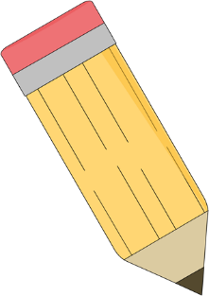
Test Page
This page will be completed at school.
1.
2.
3.
4.
5.
6.
7.
8.
9.
10.
My spelling score is ____
My arithmetic score is____

Slide 5
Week 2
/t/
Date of test: Thursday 12th June
Look and Say | Cover | Write 1st try | Check and Cover again | Write 2nd try | Check ✓
butter
cats
dept
doubt
paste
taste
twenty
after
again
any

Slide 6
Test Page
This page will be completed at school.
1.
2.
3.
4.
5.
6.
7.
8.
9.
10.
My spelling score is ____
My arithmetic score is____

Slide 7
Week 3
/z/
Date of test: Thursday 19th June
Look and Say | Cover | Write 1st try | Check and Cover again | Write 2nd try | Check ✓
amaze
buzzer
blouse
choose
cozy
crazy
dazzle
desert
bath
beautiful

Slide 8
Test Page
This page will be completed at school.
1.
2.
3.
4.
5.
6.
7.
8.
9.
10.
My spelling score is ____
My arithmetic score is____

Slide 9
Week 4
/z/
Date of test: Thursday 26th June 2025
Look and Say | Cover | Write 1st try | Check and Cover again | Write 2nd try | Check ✓
drizzle
fizz
guzzle
jazz
lazy
posses
scissors
zero
behind
because

Slide 10
Test Page
This page will be completed at school.
1.
2.
3.
4.
5.
6.
7.
8.
9.
10.
My spelling score is ____
My arithmetic score is____

Slide 11
Week 4
/eer/
Date of test: Thursday 3rd July 2025
Look and Say | Cover | Write 1st try | Check and Cover again | Write 2nd try | Check ✓
beard
deer
cheer
ear
fear
here
near
rear
smear
spear

Slide 12
Test Page
This page will be completed at school.
1.
2.
3.
4.
5.
6.
7.
8.
9.
10.
My spelling score is ____
My arithmetic score is____

